Slide 1

Introduction to Recognition Systems:
Character Recognition Using Moments
Efe Ertekin
Student Number: 041701006
Department of Computer Engineering

Slide 2
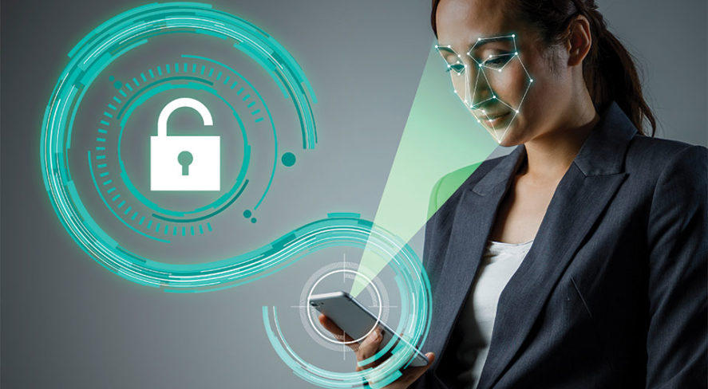
What is the purpose of the project?
It is a project on learning and developing the ideas underlying character recognition systems.

Slide 3
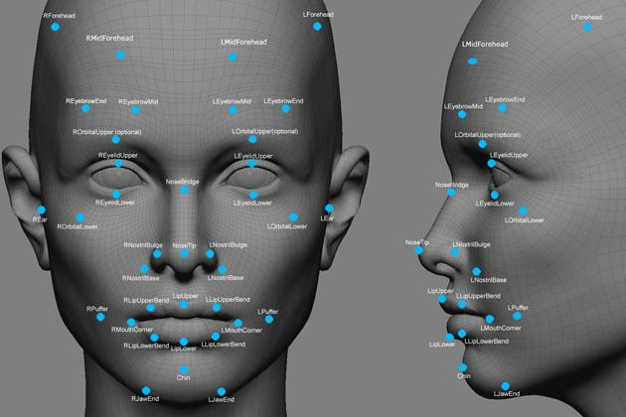
Where are recognition systems used?
Facial recognition systems
Iris recognition
Speech recognition
Fingerprint recognition
Signature recognition
etc.

Slide 4
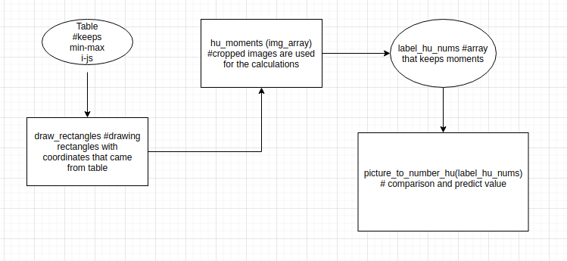
UML DIAGRAM

Slide 5
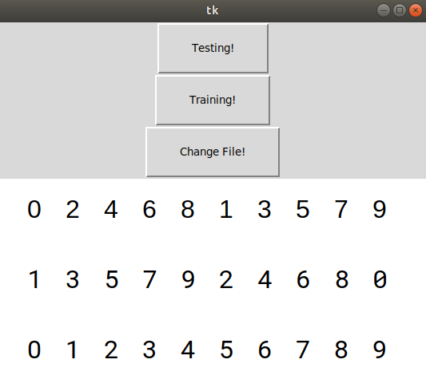
Main Menu

Slide 6
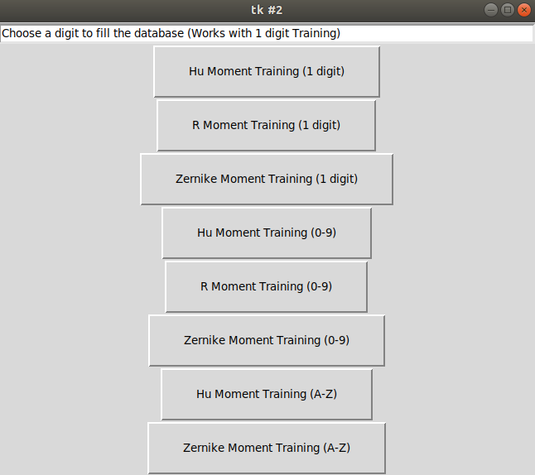
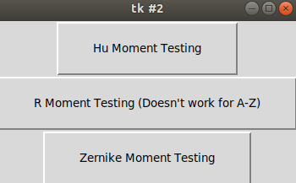
Testing and Training Windows

Slide 7
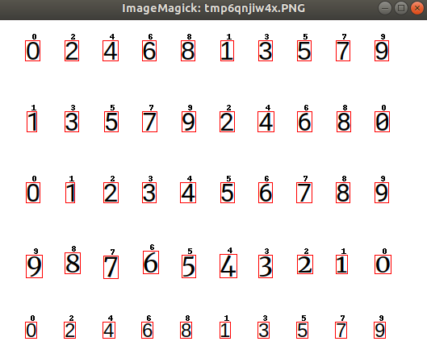
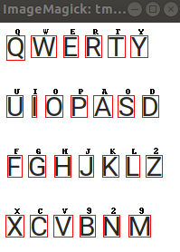
Sample Outputs

Slide 8
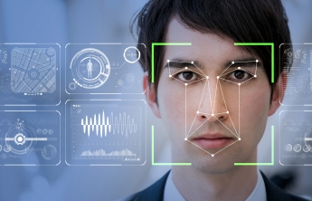
THANKS FOR LISTENING!

